Slide 1



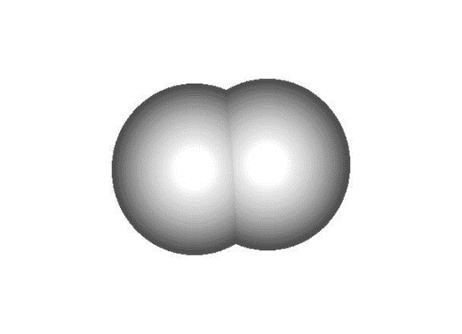
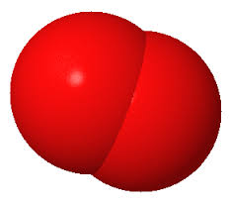
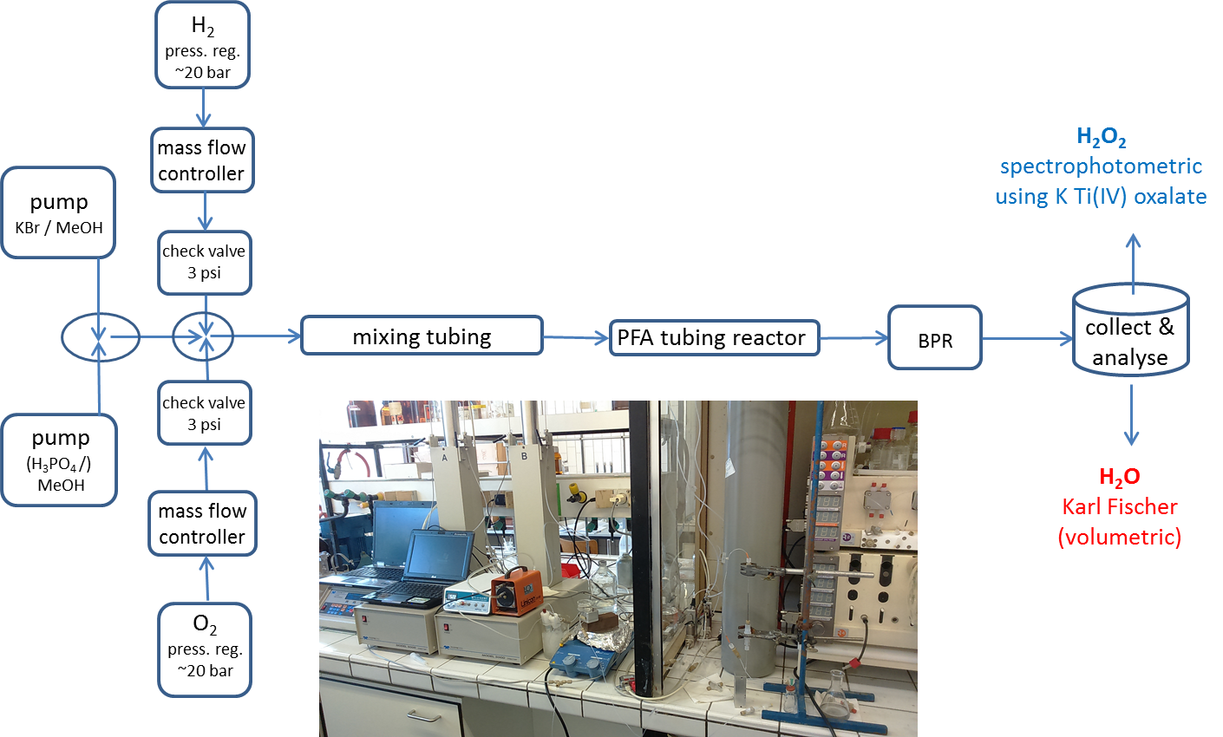
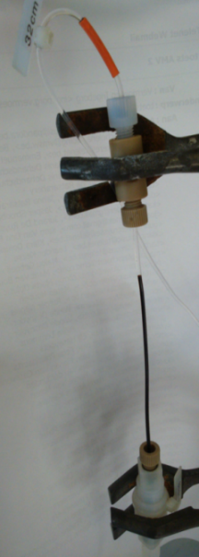
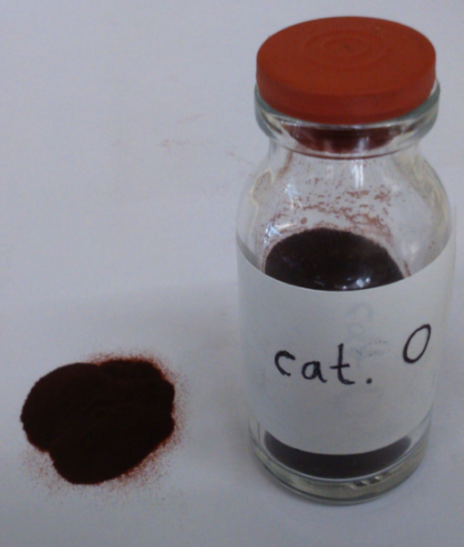
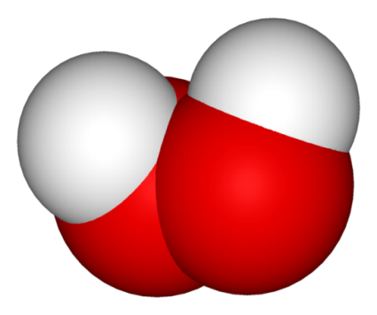
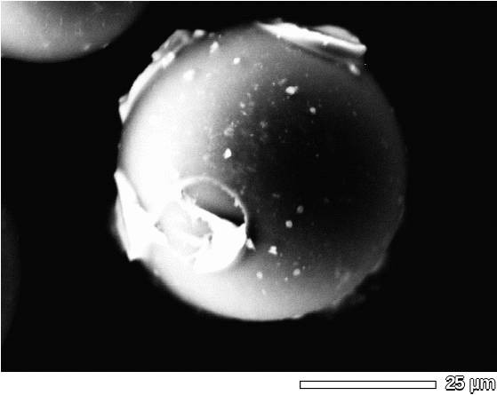


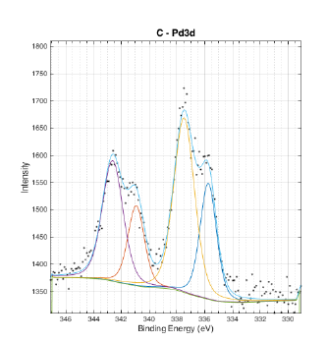
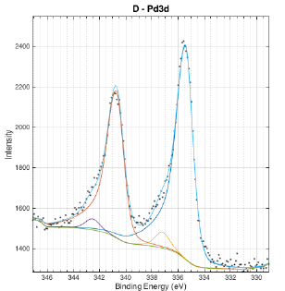
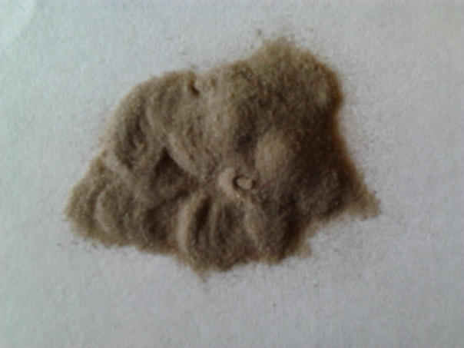
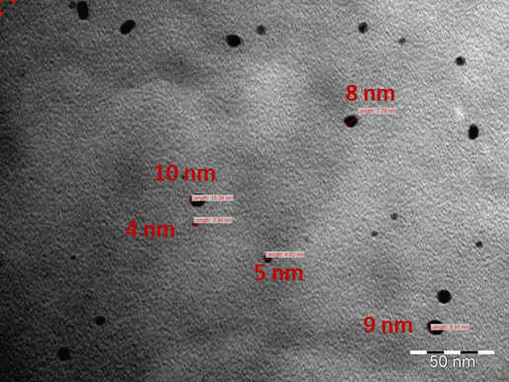
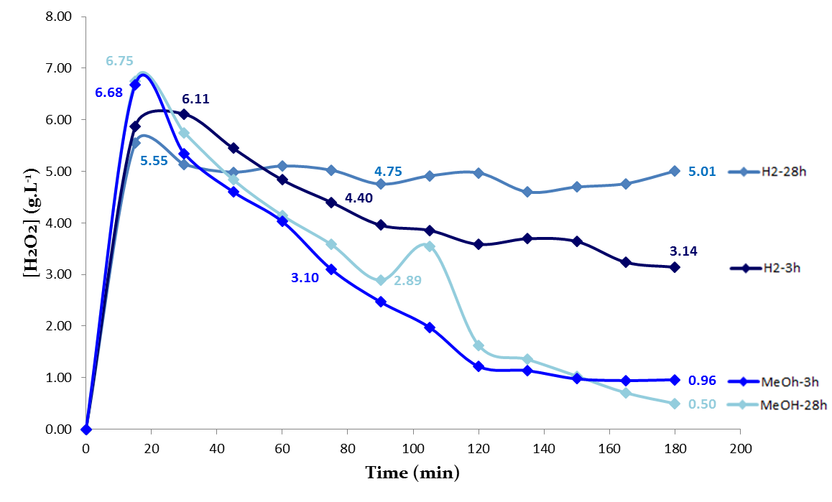
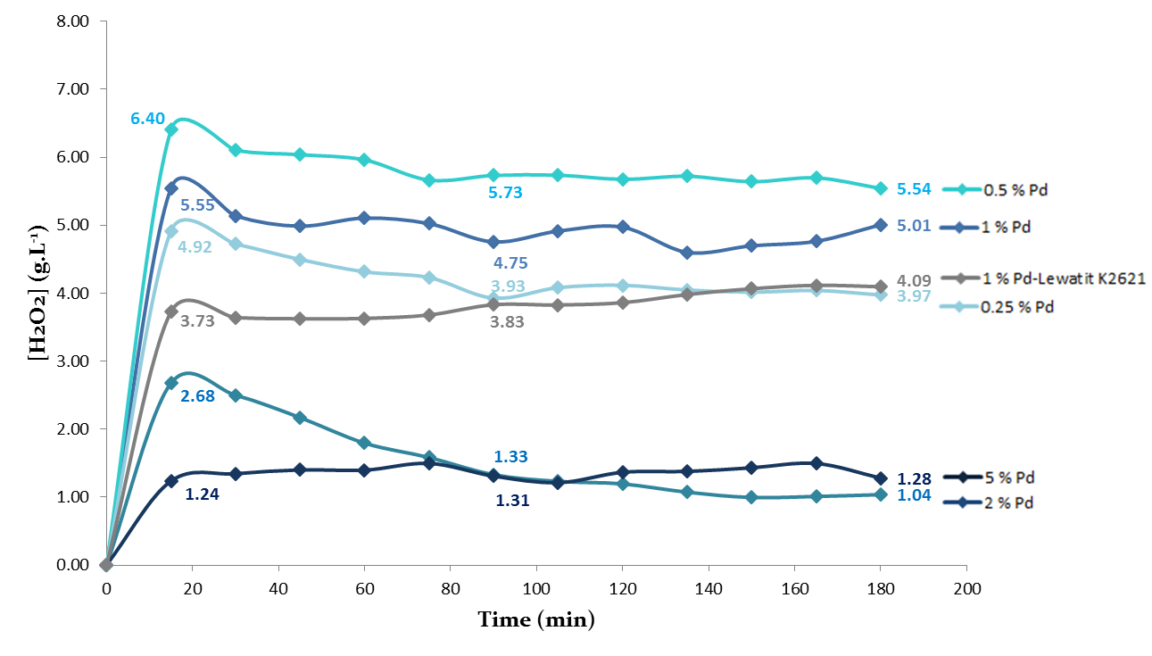
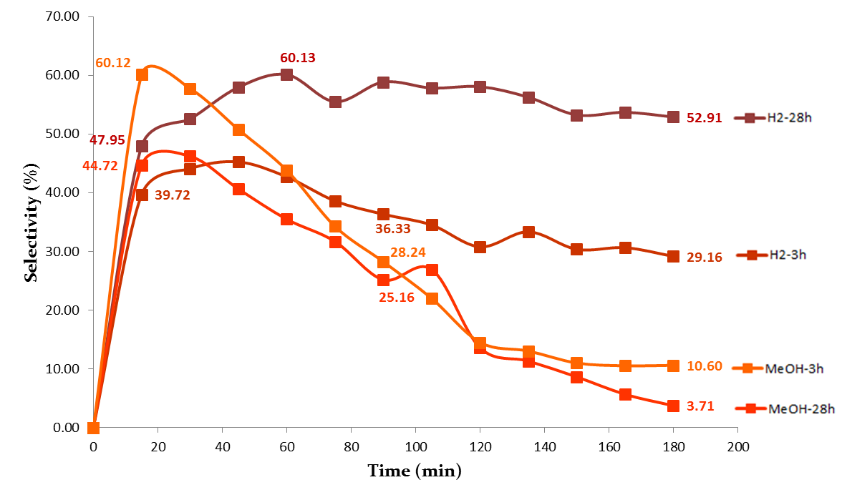
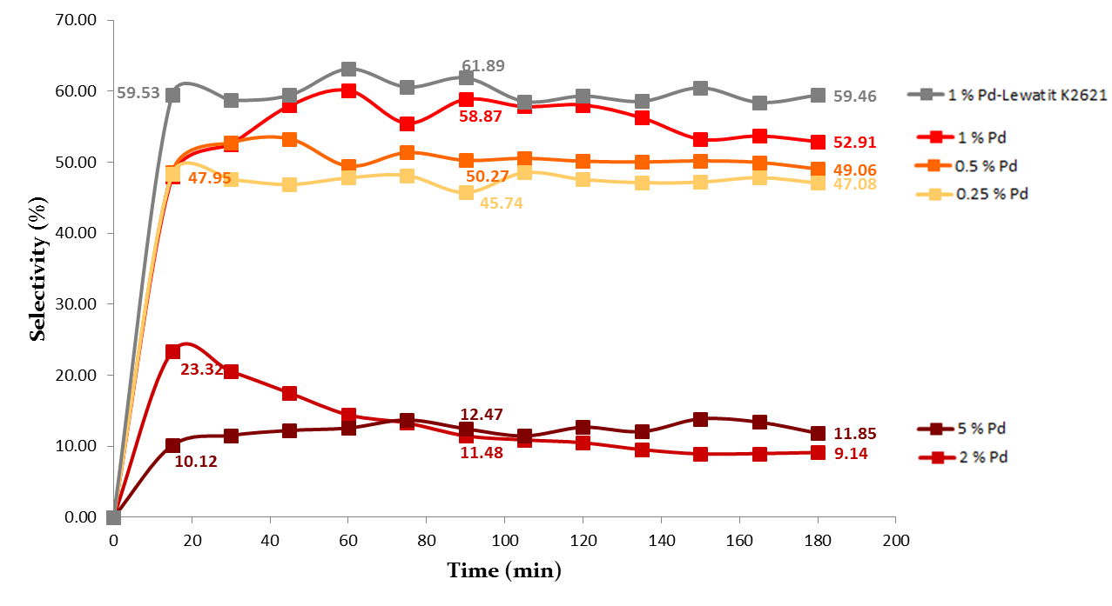
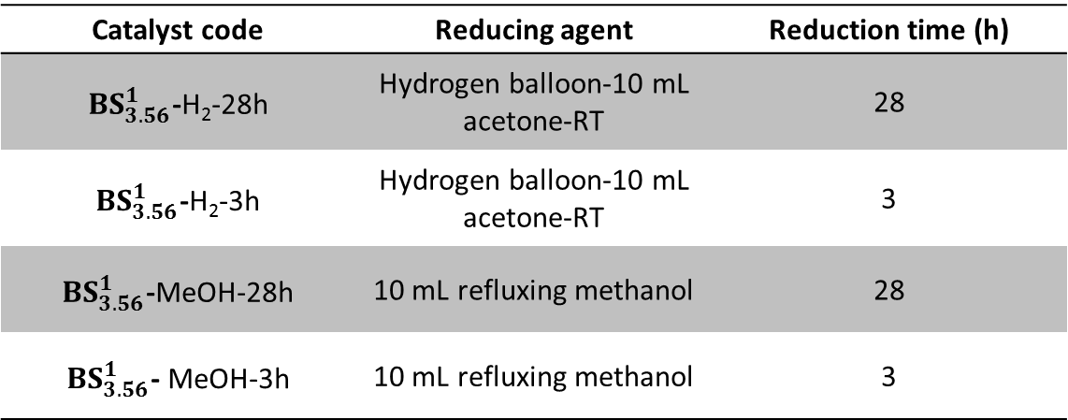
Palladium supported on sulfonated polystyrene resins as catalyst for the direct flow synthesis of H₂O₂
Eduard Dolušić, Aurélie Plas and Steve Lanners
Unit of Organic Chemistry, University of Namur
Namur Medicine & Drug Innovation Center (NAMEDIC), Namur Research Institute for Life Sciences (NARILIS), B-5000 Namur, Belgium
eduard.dolusic@unamur.be
1. Background and objectives
Hydrogen peroxide is a versatile and ‘green’ oxidising agent (the only by-product is water) widely used as a bleaching agent in the paper and textile industries.¹ It also finds many applications in the chemical industry, water treatment, semiconductor wafer cleaning and low-cost fuel cell technology.² However, it is routinely produced on the large scale by the environmentally unfriendly anthraquinone process. Therefore, direct H₂O₂ synthesis (from gaseous H₂ and O₂) has emerged as a desirable alternative.³ Flow chemistry and the microreactor technology have been successfully used for this process by several groups.⁴ Our interest lies in developing an integrated microfluidic process for H₂O₂ direct synthesis, possessing a minimalised ecological footprint while improving the results described in the literature.
2. Experimental set up
H₂ + O₂
3. The catalysts – general remarks
Catalytic systems based on palladium supported on strongly acidic macroreticular polystyrene resins have been described by several groups.⁵ We started with commercial Amberlyst-15® and loaded it with Pd(II) following the method described by Blanco-Brieva et al. This permitted reaching 2.69 % wt. H₂O₂ as the maximal concentration when adapting the experimental conditions from Inoue’s work (flow (methanolic working solution) = 10 μL/min, flow (H₂) = 1.67 sccm, flow (O₂) = 3.33 sccm).⁴
As particle size of Amberlyst-15® is not convenient for microfluidic applications, we decided to prepare our own catalysts which possess a more
narrow particle size distribution (40 - 80 µm), starting from commercially available Bio-Beads® (polystyrene-divinylbenzene resin).
2H₂ + O₂ -> 2H₂O
2H₂O₂ -> 2H₂O + O₂
H₂O₂ + H₂ -> 2H₂O
H₂O₂
4. The catalysts – preparation and characterisation
XPS analysis (catalyst BS ¹_{3.63}):
Preparation:
- sulfonation of Bio-Beads S-X12®
- Pd immobilisation in a solvent
- reductive treatment (Pd(II) -> Pd(0))
Reductive treatment:
Characterisation :
- titration : resin capacity
- SEM: size distribution
- BET: specific surface area
- porosimetry
- ICP: Pd amount
- XPS: Pd species
- TEM: size of Pd nanoparticles
Catalyst code | Reducing agent | Reduction time (h)
 | Hydrogen balloon-10 mL acetone-RT | 28
 | Hydrogen balloon-10 mL acetone-RT | 3
 | 10 mL refluxing methanol | 28
 | 10 mL refluxing methanol | 3
338,0 eV
335,8 eV
BS ^{x}_{y}
%Pd loaded
resin capacity
[meq (H⁺) / g]
336,2 eV
2 Pd species : Pd^{II} & Pd⁰
1 Pd species : Pd⁰
5. Measured/calculated parameters
7. Catalyst BS¹_{3.56}
- evaluation of reducing conditions
8. Catalyst BS¹_{3.56}
- evaluation of %Pd loaded
[H₂O₂] % wt. = m (H₂O₂) / m (final solution)
Selectivity vs. H₂O formation
S = [H₂O₂] / ([H₂O₂] + [H₂O])
% H₂ conversion = ([H₂O₂] + [H₂O])_{formed} / [H₂]_{introduced}
6. Standard conditions were
established using catalyst BS¹_{4.76}
50 mg ~ 10 cm of catalyst
0.42 sccm H₂, 0.83 sccm O₂
50 μL/min of 25 ppm KBr in MeOH (no H₃PO₄)
ambient temperature
BPR_{exit} 8 bar; system press. 6.5-8 bar
typical result 0.7 % wt. H₂O₂, S ~50 %, conversion >80 %
best result (cat. amount and all flows tripled) 0.98 % wt. H₂O₂, S = 63 %, conversion = 94 %
The influence of the catalyst preparation method was investigated, including % of Pd(II) loaded, the immobilisation solvent and the reductive treatment for the conversion to Pd(0).
The reducing conditions significantly affected the catalytic performances. Reduction by MeOH afforded a higher activity in H₂O₂, but also H₂O formation – the latter by H₂O₂ decomposition and/or other side reactions. A better selectivity was achieved using reduction by H₂ in acetone, especially after prolonged treatment (~28 h).
This catalyst batch was then prepared by using H₂ as the reducing agent for 28h. We noted that the highest concentration of H₂O₂ was obtained using 0.5% Pd on Bio-Beads® (average [H₂O₂ ] = 0.74 % wt.). On the contrary, the selectivity was slightly better when using 1% Pd. As the latter catalyst seemed to have a better recyclability (details not presented), we have chosen it for future work.
9. Conclusion
We have been able to establish optimal conditions for a direct flow synthesis of H₂O₂ by using Pd supported on sulfonated polystyrene resins as the catalyst. The gas and liquid flow rates, gas ratio and the catalyst amount were optimized, which enabled a further study on the effect of the reducing agent, the reduction time for the preparation of the catalysts, as well as the influence of Pd loading. We have learned to master the reaction conditions, rendering the results more reproducible and easier to interpret. Further experiments are in progress, including kinetic studies, using bi- or trimetallic catalysts and an integration of our system with an H₂O₂ in-flow concentration system.
10. References and Acknowledgments
Hage, R. Lienke, A. Angew. Chem. Int. Ed. 2006, 45, 206.
Lane, B.S, Burgess, K, Chem. Rev. 2003, 103, 2457; De Faveri et al, Chem. Soc. Rev. 2011, 40, 1722; Fukuzumi, S. et al, Electrochim. Acta 2012, 82, 493.
Campos-Martin, J. M. et al, Angew. Chem., Int. Ed. 2006, 45, 6962; Edwards, J.K. et al, Science 2009, 323, 1037; Edwards, J.K. and Hutchings, G.J. Angew. Chem., Int. Ed. 2008, 47, 9192; Samanta, C, Appl. Catal. A 2008, 350, 133; García-Serna, J. et al, Green Chem. 2014, 16, 2320;
Inoue, T. et al, Chem. Lett. 2009, 38, 820, Chem. Eng. J. 2010, 160, 909, Fuel Process. Technol. 2013, 108, 8, Chem. Eng. J. doi: doi:10.1016/j.cej.2014.11.019, Catal. Today doi: 10.1016/j.cattod.2014.03.065; Jaenicke, S. et al, Appl. Catal. A 2007, 317, 258, J. Catal. 2010, 269, 302; Voloshin, Y. et al, Catal. Today 2007, 125, 40, Chem. Eng. Sci. 2010, 65, 1028; Turunen, I. et al, Russ. J. Gen. Chem. 2012, 82, 2100.
Blanco-Brieva, G. et al, Chem. Commun. 2004, 1184; Burato, C. et al, Appl. Catal., A 2009, 358, 224; Kim, J. et al, ACS Catal. 2012, 2, 1042; Sterchele, S. et al, Appl. Catal., A 2013, 468, 160; Biasi, P. et al, Ind. Eng. Chem. Res. 2013, 52, 15472; Chung, Y-M. et al, Chem. Commun. 2011, 47, 5705.
This work is supported by WBGREEN – MICROECO (Convention No. 1217714). We are grateful to Dr. Pierre Miquel (Solvay nv) for useful discussions and advice and to Corry Charlier (Unamur) for assistance with the electron microscopy,

