Slide 1



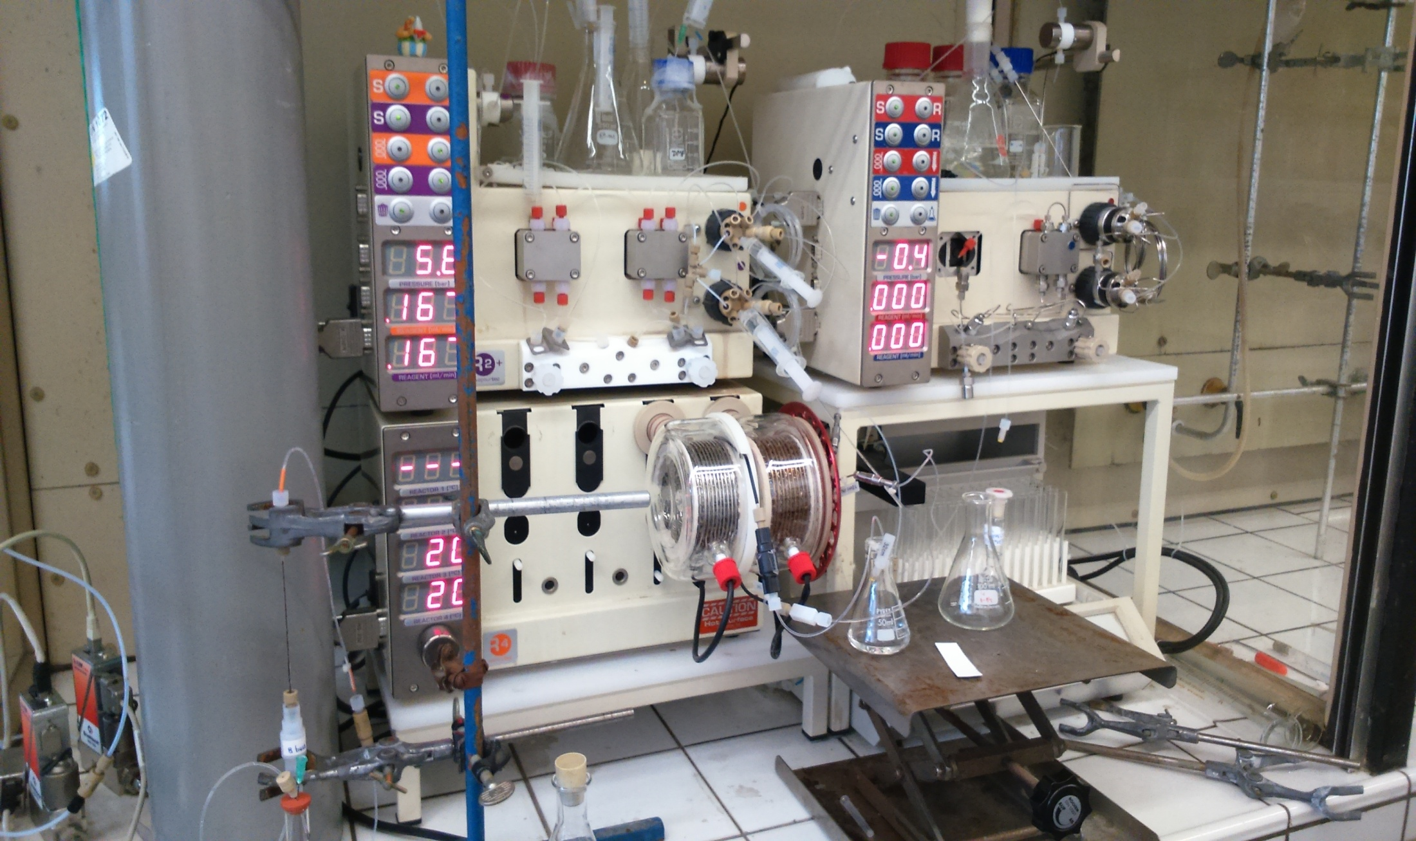
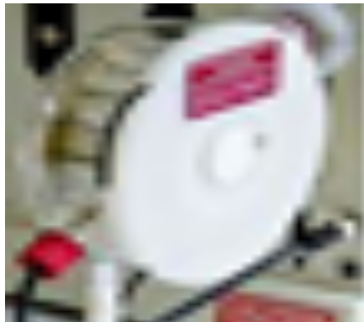
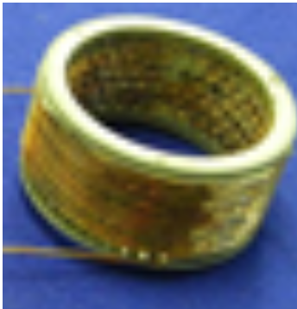
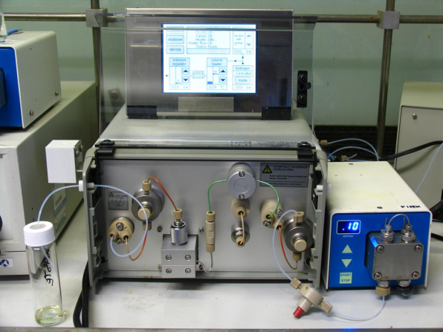
FLOW SYNTHESIS OF COMBRETASTATIN A-4
Ines Cazin, Laurent De Backer, Stéphane Collin, Titouan Desrues, Eduard Dolušić, Steve Lanners*
Laboratoire de Chimie Organique de Synthèse, Department of Chemistry and Namur Medicine & Drug Innovation Center (Namedic), 61 rue de Bruxelles, 5000 Namur, Belgium
ines.cazin@ymail.com, steve.lanners@unamur.be
Introduction
Introduction
Combretastatin A-4 (1) is a natural product isolated from the South African bushwillow tree Combretum caffrum and endowed with a powerful inhibitory activity on microtubule formation as well as a related antiangiogenic activity.¹ As such, 1 has a strong potential in anticancer therapy. A lot of effort has been done on the development of new derivatives of this compound, in order to improve the properties such as solubility and stability, and to understand the structure-activity relationships around this series.²
Envisaged Flow Synthesis of (1)
Synthesis of terminal alkyne
The synthesis of active pharmaceutical ingredients (API) using only flow chemistry has been pioneered by S.V. Ley et. al. in 2010.³ In order to further illustrate the feasibility of this strategy, we have devised a synthetic route for 1 which only relies on flow chemistry (Scheme 1).
flow rate [µL/min] | temperature [ºC] | pressure [bar] | reactor material | base | residence time [min] | conversion
100 | 0 | 6.6 | inox | KtOBu | 50 | 60 %
100 | 0 | 6.6 | inox | KtOBu | 50 | 45 %
100 | 20 | 3.2 | plastic | KtOBu | 50 | 49 %
166 | 21 | 4.0 | plastic | KtOBu | 30 | 46 %
100 | 26 | 4.9 | plastic | KtOBu | 50 | 55 %
100 | 27 | 4.7 | plastic | KtOBu | 50 | 57 %
100 | 40 | 3.2 | plastic | KtOBu | 50 | 51 %
200 | 40 | 3.2 | plastic | KtOBu | 25 | 44 %
500 | 40 | 3.2 | plastic | KtOBu | 10 | 39 %
100 | 40 | 4.7 | inox | KtOBu | 50 | 55 %
167 | 0 | 4.3 | inox | NaOMe | 30 | 12 %
167 | 20 | 4.2 | inox | NaOMe | 30 | 38 %
167 | 21 | 4.3 | inox | NaOMe | 30 | 16 %
166 | 24 | 6.5 | inox | NaOMe | 30 | 18 %
166 | 40 | 6.5 | inox | NaOMe | 30 | 17 %
167 | 40 | 4.2 | inox | NaOMe | 30 | 37 %
167 | 40 | 4.3 | inox | NaOMe | 30 | 12 %
Flow conditions: A solution of 2 (0.07 M), 3 (0.06 M) in MeOH, and base (0.12 M) in MeOH. ª Conversion is based on ¹H NMR analysis of crude materials.
Synthesis of arylalkynes
entry | Ar - X | R | catalyst^{c} | commentary^{d}
1ª |  |  | - | a small amount of product
2ª |  |  | - | mostly starting materials
3^{b} |  |  | Pd(PPh₃)₂Cl₂ | 53 %
4^{b} |  |  | Pd(PPh₃)₂Cl₂ | 18 %
entry | Ar - X | R | catalyst^{c} | commentary^{d}
1^{a,e} |  |  | - | 22 %
2^{b} |  |  | - | 4 %
3^{b,e} |  |  | Pd(PPh₃)₂Cl₂ | 63 %
4^{b} |  |  | Pd(PPh₃)₂Cl₂ | impure product
Reaction conditions: A solution ofªalkyne (1.2 M), Ar - X (1 M), base (1.1 M) and ^{b}alkyne(0.6 M), Ar - X (0.5 M), base (0.55 M) in DMF was injected from pump at 0.167 mL/min. ^{c} 0.50 mol % Pd(PPh₃)₂Cl₂ was added. The palladium catalyst and leached trace amount of copper were removed with QuadropureTM 50, 400-600 µm. ^{d} Isolated yields after chromatography on silica gel.
Reaction conditions: A solution of ª alkyne (1.2 M), Ar - X (1 M), base (1.1 M) and ^{b}alkyne(0.6 M), Ar - X (0.5 M), base (0.55 M) in DMF was injected from pump at 0.167 mL/min.^{c}0.50 mol % Pd(PPh₃)₂Cl₂ was added. The palladium catalyst and leached trace amount of copper were removed with QP-TU, 400-600 µm. ^{d} Conversion is based on ¹H NMR analysis of crude materials. ^{e} Reactor blocked, reaction terminated prematurely.
Hydrogenation
entryª | Ar - X | R | catalyst^{c} | commentary^{d}
1 |  |  | Pd(PPh₃)₂Cl₂ | 25 %
2 |  |  | Pd(PPh₃)₂Cl₂ | only starting materials
3 |  |  | Pd(PPh₃)₂Cl₂ | only starting materials
concentration (mg/mL) | catalyst | commentary
12.4 | Pd/CaCO₃/Pb | product
12.4 | Pd/BaSO₄/quinoline | -
Scheme 1. Proposed flow synthesis of Combretastatin A-4
ª Reaction conditions: A solution of 7 (1.2 M), 5 (1 M), 8 (1.1 M) in DMF were mixed through pumps into a T-mixer at a total flow rate of 0.167 mL/min. ^{b} Conversion is based on ¹H NMR analysis of crude materials.
Figure 1. ThalesNano H-Cube®
Conclusion
Our idea was to integrate all of the steps of this synthetic sequence in a continuous flow operation, whereby the experimental details such as the choice of the solvent and purification of the products are of utmost importance. Once we discovered the synthetic route, we will be able to systematically optimize and improve it. We have been investigating reactions of Bestmann-Ohira and Sonogashira using Vapourtec (R- and modern E-series) machines. The final step was catalytic hydrogenation, which was conducted in the H-Cube unit from ThalesNano (Figure 1).
References and Acknowledgment
1. a) Lin, C. M., et al, Mol. Pharmacol. 1988, 34, 200; b) Holt, H., et al, Top. Heterocycl. Chem. 2006, 11, 465; c) Kerr, D. J., et al, Bioorg. Med. Chem. 2007, 15, 3290.
2. a) Marrelli, M., et al, Curr. Med. Chem. 2011, 18, 3035; b) Shan, Y., et al, Curr. Med. Chem. 2011, 18, 523; c) Spatafora, C., et al, Anticancer Agents Med. Chem. 2012, 12, 902; d) Mikstacka, R., et al, Cell.Mol. Biol. Lett. 2013, 18, 368.
3. Hopkin, M. D., et al, Chem. Comm. 2010, 2450.
This work is supported by WBGREEN – MICROECO (Convention No. 1217714).

